Slide 1
Analyzing Health Equity Using Household Survey Data
Lecture 15
Measuring and Explaining Inequity in Health Service Delivery

Slide 2
Equitable distribution of health care is a widely supported principle
  Distinguish between
    Horizontal equity – equal treatment of equals
    Vertically equity – appropriate unequal treatment of unequals
  In health care, most attention given to “equal treament for equal medical need irrespective of income, race, etc”
  Methods available to measure and explain horizontal inequity in health care utilisation
Notes:
1. Equitable distribution of health care is a principle subscribed to in many countries, often explicitly in legislation or official policy documents (van Doorslaer, Wagstaff, and Rutten 1993)

Slide 3
Identifying horizontal inequity through the need-standardized distribution of health care
  Care is unequally distributed by income
  But so is need
  To assess whether care is equitably distributed:
    Either compare actual distribution of care (by income) with distribution of need
    Or assess (in)equality in need-standardized distribution care
  Income-related distribution of:
    Actual use describes inequality
    Need-standardized use describes inequity
Notes:
Here we use ‘income’ as a short-hand for a measure of living standards.
There will typically be inequality in the utilization of health care in relation to socioeconomic characteristics, such as income. Typically, in high-income countries poorer individuals consume more health care resources as a result of their lower health status and so greater need for health care. Obviously, such inequality in health care use cannot be interpreted as inequity. In low-income countries, the lack of health insurance and purchasing power among the poor typically mean that their utilization of health care is less than that of the better-off despite their greater need (Gwatkin et al. 2003; O’Donnell et al. forthcoming). In this case, the inequality in health care use does not fully reflect the inequity.
The measurement of horizontal inequity in health care use can proceed in much the same way as the standardization methods covered in lecture 5. For example, one seeks to establish whether there is differential utilization of health care by income after standardizing for differences in the need for health care in relation to income.
In empirical analyses, expected utilization, given characteristics such as age, gender, and measures of health status, is used as a proxy for “need.” Complications to the regression method of standardization arise because measures of health care utilization typically are nonnegative integer counts (e.g., numbers of visits, hospital days, etc.) with very skewed distributions. As discussed in lecture 11, nonlinear methods of estimation are then appropriate. But the standardization methods presented in lecture 5 do not immediately carry over to nonlinear models. They can be rescued only if relationships can be represented linearly. In this lecture, we therefore concentrate on standardization in nonlinear settings.

Slide 4
What is need?
Not easily answered – illness, capacity to benefit from health care,…
With available data, rely on age, gender and health indicators to proxy for need
That is, define need as expected utilisation given these variables
It is not possible to measure horizontal inequity without specifying a vertical equity norm
  Is generally assumed that, on average, differential utilisation across different levels of need is appropriate
  Given this, assess whether there is equal utilisation for the same level of need

Slide 5
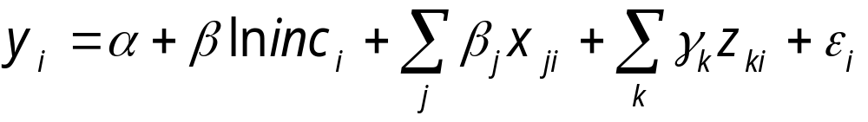
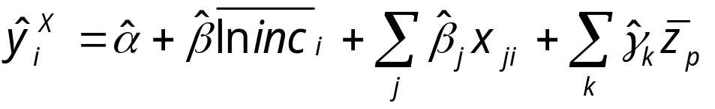
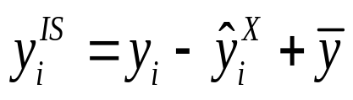
Need standardization by linear regression
Analogous to (indirect) demographic standardisation
Let medical care use (y_{i}) be explained linearly by
  where ln inc is log income, x_{j} are the need-proxies and z_{k} are the non-need control variables
Need-expected utilisation:
  where overscore indicates mean values and ^ indicates OLS coefficients
(Indirectly) need standarised utilisation is:
Notes:
When health care use is modelled by linear regression, the standardization procedure is exactly as presented in lecture 5. The need variables are included among the x’s. The control, or z, variables should include nonneed correlates of health care utilization for which we do not want to standardize but which would bias the coefficients on the need variables if omitted from the regression (Gravelle 2003; Schokkaert and van de Voorde 2004). For example, suppose that some groups with poor health (an x variable), for example, people who are disabled or handicapped, receive more generous insurance coverage (a z variable) than the nondisabled. If we were to estimate the standardizing regression excluding a variable capturing the better coverage, then the coefficient on the poor health variable would—to some extent—pick up the effect of more generous cover, over and above the direct effect of greater need. That would overestimate the “appropriate vertical need difference” as embodied in the coefficient of poor health.
Equivalently, HI_WV can be obtained as the difference between the concentration index for actual utilization and that for need-predicted utilization.
This procedure rests on the assumption that once observable need indicators have been controlled for, any residual variation in utilization is attributable to nonneed factors. Given that the data available on need indicators typically are limited, that is likely to be a strong assumption. It will result in biased measurement of horizontal inequity in the case that unobservable variation in need is correlated with income. Schokkaert, Dhaene, and Van de Voorde (1998) discuss this issue in the context of the related literature on risk adjustment.

Slide 6
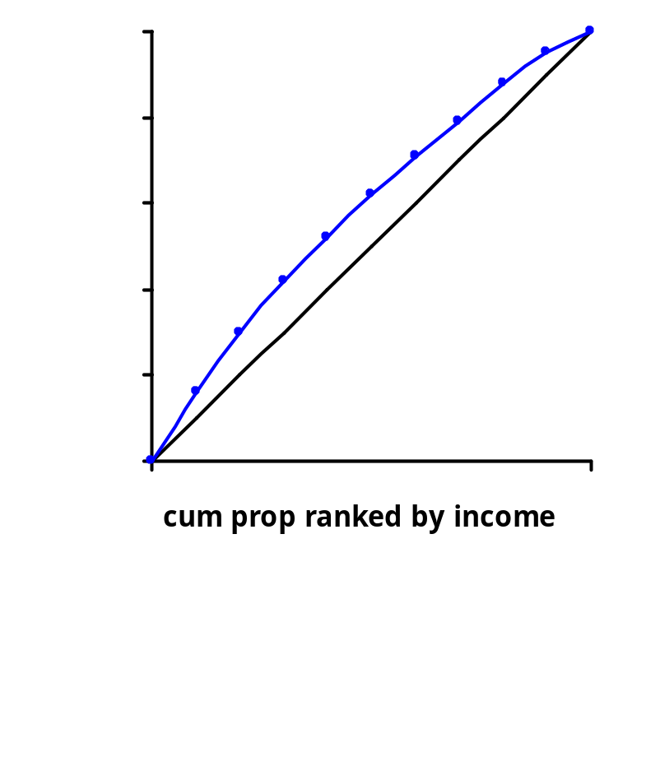
Assessment and measurement of inequity based on the need-standardised concentration curve
Need-standardised concentration curve L*(y) lies above diagonal when, for given need, use is concentrated among the poor
Concentration index C* derived from the L*(y) is a measure of horizontal inequity (HI)
HI=C*>0 if inequity “favours” rich, HI=C*<0 if it “favours” poor
Equity only if HI=C*=0
Notes:
7

Slide 7
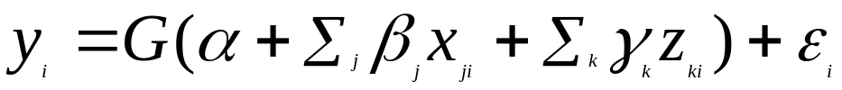
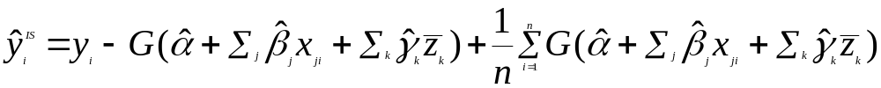
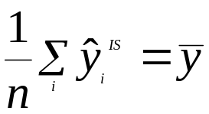

Need-standardization with nonlinear models
Since health care utilisation if often a binary, categorical
or count variable, nonlinear models are preferable
Let y be a nonlinear function of the need and control
variables
where G() takes particular forms for probit, logit, negbin,..
One could define standardized use by:
Then but depends on the values to
which z are set in the prediction.
Hence the concentration index depends on arbitrary z values
Notes:
Measures of health care use are typically nonnegative integer counts, for example, number of visits to a doctor or days in a hospital. In a sample, there will typically be a large proportion of observations with no utilization and very few observations, corresponding to individuals falling severely ill, with utilization very much above the mean. Given this, it may be considered appropriate to model the determinants of the use/nonuse probability separately from the number of visits conditional on any use. Although the least squares regression method of indirect standardization could be used with such data, it would not guarantee that the predicted values from the standardizing regression lie in the permitted range of (0,1) for binary variables and at or above zero for nonnegative counts. This can be avoided by using nonlinear estimators.
If there were no z variables included in equation 15.1, then predicted values obtained from the model could be interpreted as need-expected utilization. Need-standardized utilization could then be defined as actual use minus need-expected utilization, as in equation 5.3, only in this case the mean of the prediction should be added, rather than the mean of the actual variable, to ensure that the mean of standardized utilization equals that of actual utilization.
However, as argued above, including z variables in the model is probably desired to avoid omitted-variables bias. Doing so in this nonlinear context leads to a problem because the effect of the z variables on need-standardized use can no longer be entirely neutralized by setting them equal to their means or indeed to any other vector of constants. As a result, the variance of the need-standardized use will depend on the values to which the z variables are set in the standardization procedure, and that will affect measures of income-related inequality, such as the concentration index.

Slide 8
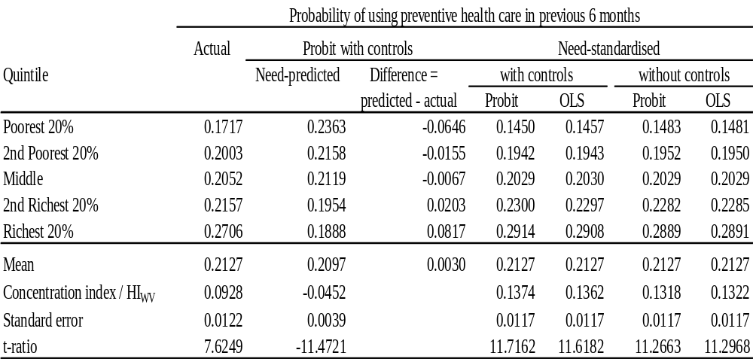
Distributions of Actual, Need-Predicted and Need-Standardized Preventive Visits to Doctor, Nurse, or Other Health Practitioner, Jamaica 1989
Notes:
Authors’ calculations from Jamaican Living Standards Survey, 1989.
The table below shows the actual need-expected and need-standardized distributions for the probability of reporting at least one preventive visit to a doctor, nurse, or other health practitioner, by quintiles of equivalent expenditure in Jamaica derived from the 1989 Survey of Living Conditions (van Doorslaer and Wagstaff 1998). The indicators used in the prediction of needed health care are demographic variables (7 age-sex dummies), self-assessed health (4 dummies), and functional limitations of activities (7 dummies). It can be seen that the actual distribution observed is clearly pro-rich, and the need-expected distribution is pro-poor. This is a result of the fact that “need,” as proxied by demographic and morbidity characteristics, is more concentrated among the lower-income groups. As a result, for the poorest fifth of Jamaicans, the probability of reporting a preventive care contact is 6.5 percent lower than would be expected on average given their need, whereas the richest 20 percent of Jamaicans report a probability of such a contact that is 8.2 percent higher than expected. It is therefore no surprise that the need-standardized distribution shows an even more pro-rich distribution than the actual distribution. After need standardization, the richest quintile’s contact probability is twice that of the poorest.
The figures reported in the table for need-predicted use and its difference from actual use are derived from a probit model including control variables, specifically (log) equivalent expenditure and health insurance status, which are set equal to their sample means to obtain the predictions. Need-standardized use is presented both with and without the inclusion of controls in the standardizing model and estimating this by both OLS and probit. In this example, results are not sensitive to either variation. It has been found elsewhere that concentration indices for standardized health care utilization are relatively insensitive to the use of OLS or nonlinear models for standardization (van Doorslaer, Masseria, and OECD Health Equity Research Group 2004; van Doorslaer et al. 2000; Wagstaff and van Doorslaer 2000). That is reassuring given the complications introduced by nonlinear models noted above. Insensitivity to the inclusion of control variables in the standardizing regression may be more specific to this example. Others have found more substantial differences (Gravelle 2003).

Slide 9
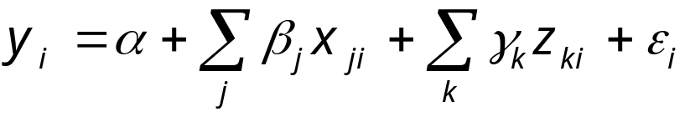
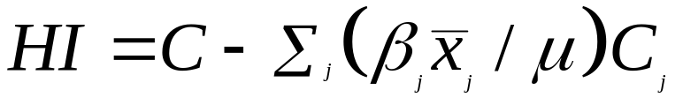
Measuring Inequity through Decomposition
  As seen in lecture 13, for any linear model:
  the concentration index for y can be written as:
  The index of horizontal inequity (HI) can be obtained directly from this decomposition:
  That is, inequity is total inequality minus need-related inequality
Notes:
In the second equation, μ is the mean of y, C_j is the concentration index for factor j and GC_e is the generalised concentration index of the the error term (see lecture 13). The terms in parentheses in the second equation are elasticities.
In lecture 13 , we noted that if a health variable is specified as a linear function of determinants, then its concentration index can be decomposed into the contribution of each determinant, computed as the product of the health variable’s elasticity with respect to the determinant and the latter’s concentration index. This makes it possible to explain socioeconomic-related inequality in health care utilization.
In fact, the decomposition method allows horizontal inequity in utilization to be both measured and explained in a very convenient way. The concentration index for need-standardized utilization is exactly equal to that which is obtained by subtracting the contributions of all need variables from the unstandardized concentration index (van Doorslaer, Koolman, and Jones 2004).
Besides convenience, the advantage of this approach is that it allows the analyst to duck the potentially contentious division of determinants into need (x) and control (z) variables and so the determination of “justified” and “unjustified,” or inequitable, inequality in health care utilization. The full decomposition results can be presented, and the user can choose which factors to treat as x variables and which to treat as z variables.

Slide 10
Explaining Inequity through Decomposition
  Can decompose total income-related inequality in observed use into:
  “acceptable”, or need-induced, inequality
  inequity, or non-need related inequality, due to
    direct contribution of income
    contribution of other, non-need variables (e.g. education, health insurance, location)
    contribution of residuals (unexplained inequality)
  HI = C - (a) = (i) + (ii) + (iii)
Notes:
1. Hence, using decomposition, one can isolate the income-related inequity in health care utilisation that comes directly from the correlation between utilisation and income after controlling for need. Then, one can identify the inequity that comes through the common correlation of both utilisation and income with third (non-need) factors such as education, helath insurance coverage and geographic location. Each of these contributions can be separated into the elasticity and income-related inequality in the factor, as seen in lecture 13.

Slide 11
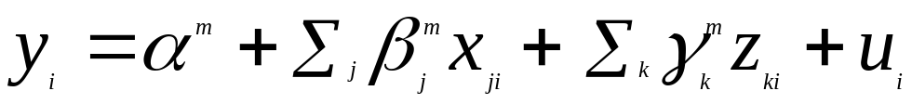
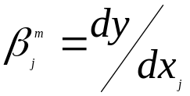
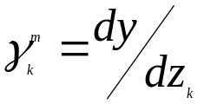
Decomposition for nonlinear models
Decomposition of the concentration index holds only if the regression model is linear
To apply to a nonlinear model, a linear approximation must be made, e.g.
where and are partial effects (evaluated at, e.g., means).
Decomposition applied to this gives:
Notes:
u in the equation is the implied error term, including approximation error in moving from the nonlinear model to a linear approximation.
Because the partial effects are evaluated at particular values of the variables, for example, the means, this decomposition is not unique. This is the inevitable price to be paid for the linear approximation. Also, unlike the truly linear case, the index of horizontal inequity, , obtained by subtracting the need contributions in equation 15.4 from the unstandardized concentration index will not equal the concentration index for need-standardized utilization calculated from the estimates of the nonlinear model parameters, as described in the previous section.

Slide 12
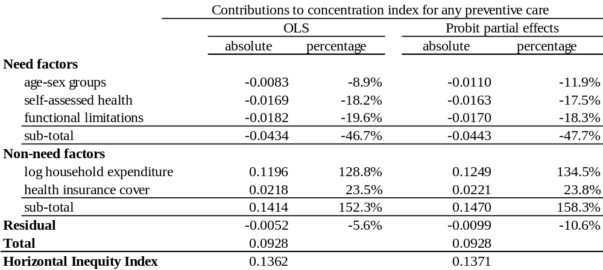
Decomposition of Concentration Index for Access to Preventive Health Care in Jamaica, 1989
Notes:
We decompose the concentration index for any use of preventive health care in Jamaica. The probability of making any use of preventive care is estimated both by least squares, in which the decomposition is exactly as presented in lecture 13, and by probit, in which case we make a linear approximation to the model using the partial effects evaluated at sample means, as in the previous slide. Need and nonneed variables are as described in notes to the previous table, although, as pointed out above, the decomposition approach allows the user to choose which factors to consider as need proxies.
We do not present the full decomposition results but provide, in the table below, the absolute and percentage contributions to the unstandardized concentration index for groups of “need” factors (age-sex dummies, self-assessed health dummies, and functional limitation dummies) and for the two “nonneed” factors.
Results are not particularly sensitive to the estimation method. The residual difference between the unstandardized concentration index and the sum of the contributions of all need and nonneed factors is larger for the partial effects probit approach, largely because this gives a slightly larger estimate of the contribution of household expenditure.
The contribution of all need factors is negative, indicating that if utilization were determined by need alone, it would be pro-poor. The aggregate contribution of all need factors is about 47 percent of the unstandardized index. Self-assessed health and functional limitations each contribute roughly twice as much as the age-sex groups. Although the distribution of need pushes utilization in a pro-poor direction, this is more than offset by the direct effect of household expenditure and of insurance coverage. If need were distributed equally, the direct effect of household expenditure on utilization would produce a concentration index 29 to 34 percent greater than that observed. There is also an indirect effect of household expenditure on utilization through health insurance coverage that raises the concentration index by 24 percent of its observed value.
The horizontal inequity index is positive, indicating that for given need, the better-off make greater use of preventive care in Jamaica. The index is not particularly sensitive to the estimation method.

Slide 13
OECD Study of Equity in Health Care Utilisation (van Doorslaer et al 2004)
  Data from 2000 wave of European Community Household Panel for 10 countries
  Data from nationally representative surveys for 11 other OECD countries
  Adults (16+) only
  Reported utilization over past 12 months
  Disposable income per equivalent adult
Notes:
1. van Doorslaer, E., C. Masseria, and OECD Health Equity Research Group. 2004. “Income-Related Inequality in the Use of Medical Care in 21 OECD Countries.” In Towards High-Performing Health Systems: Policy Studies, ed. OECD Health Project, 109–66. Paris: OECD

Slide 14
Utilisation and explanatory variables
  Utilisation – GP visits, specialist visits, hospital admissions, dental care visits
  Need indicators:
    Self-reported health
    Health problems and degree of limitation
  Other variables:
    Health insurance coverage only for Australia, France, Germany, Ireland, Switzerland, UK and US
    No region of residence for Denmark, Finland, Netherlands, Sweden and very limited for most other countries

Slide 15
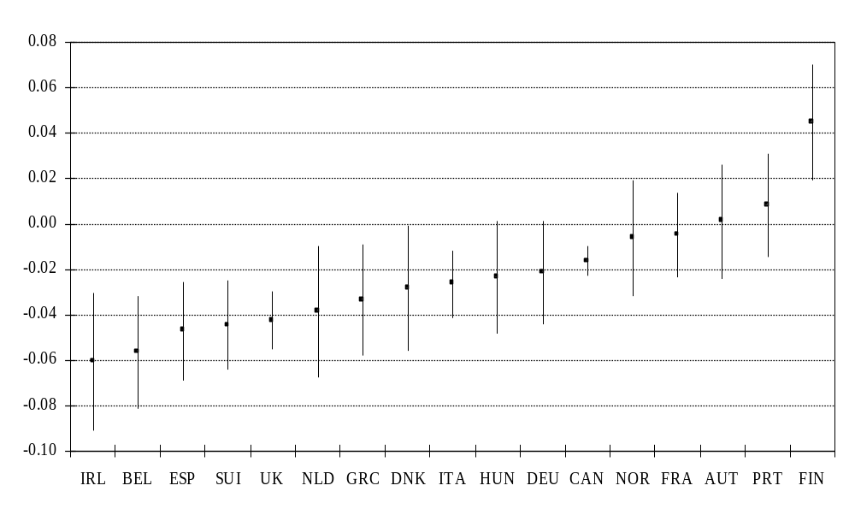
Horizontal Inequity indices (95% confidence intervals) – Number of GP visits
Notes:
Significant pro-poor inequity in Ireland (IRL), Belgium, Spain, Switzerland, UK, Netherlands, Greece, Denmark, Italy and Canada
Significant pro-rich inequity only in Finland.
These and all other results reported here were computed from linear regression but results are robust to using non-linear models for estimation and linear approximation for decomposition.

Slide 16
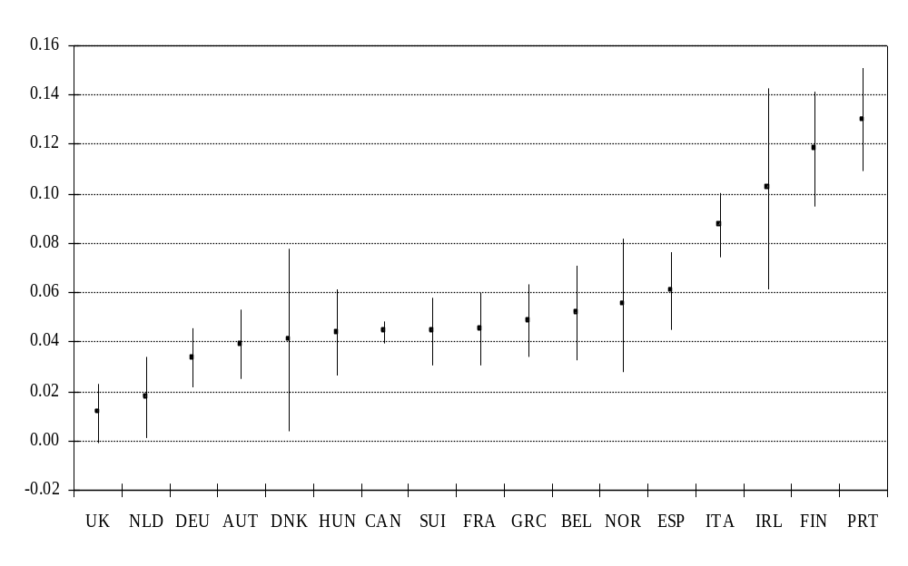
Horizontal Inequity indices - probability of specialist visit
Notes:
Significant pro-rich inequality in access to specialist care in all countries.
Most extreme on Portugal and smallest in UK. But latter might be because the variable is access to hospital outpatient care in UK.

Slide 17
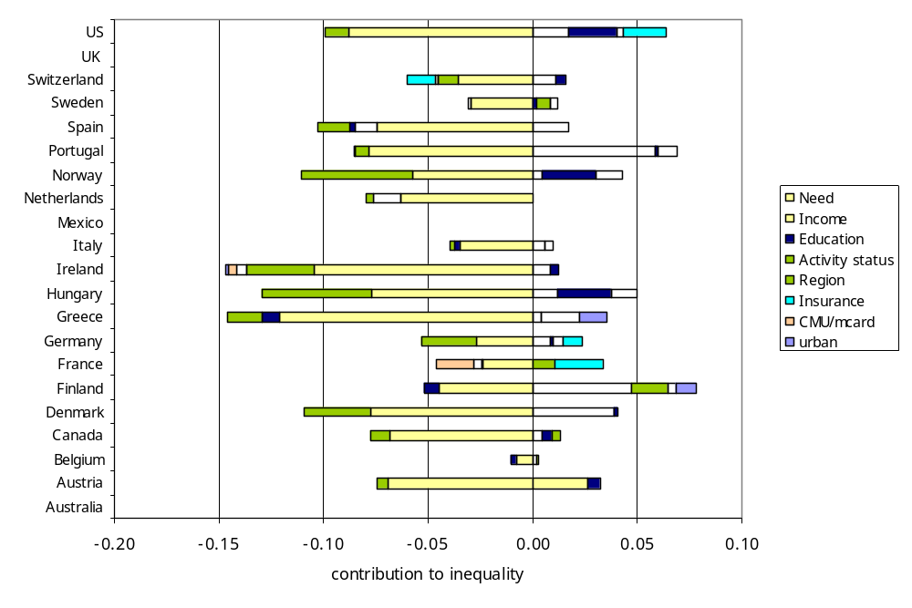
Decomposition of inequality in total number of physician visits
Notes:
Note this is all physician visits (GP and specialist).
It is the decomposition of all income-related inequality – the concentration index – not the horizontal inequity index, which can be computed by subtracting the contribution of the need factors.
Need factors generally contribute to pro-poor inequality in utilisation of physician care. This is also true of activity status.
The direct effect of income generally makes the largest contribution to pro-rich inequity, that is inequality in favour of the better off after controlling for differences in need.

Slide 18
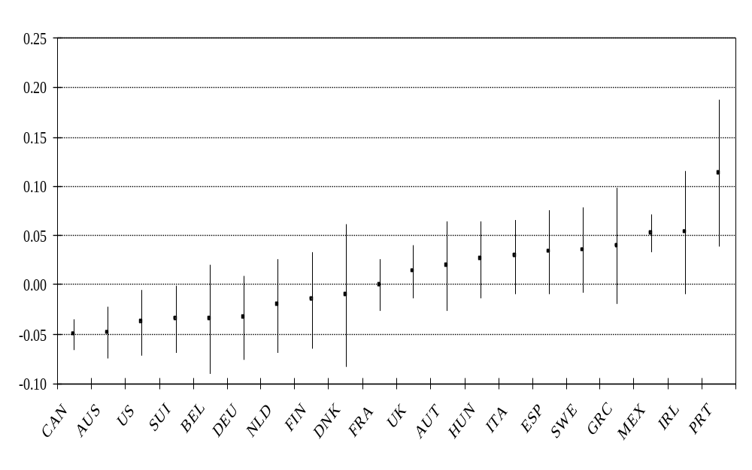
Horizontal Inequity indices - probability of hospital admission
Notes:
There is significant pro-rich inequity in hospital admissions in Mexico and Portugal.
Significant pro-poor inequity in Canada, Australia, USA and Switzerland. For some of these countries this might reflect pro-rich inequity in specialist care, which can reduce hospital admissions.

Slide 19
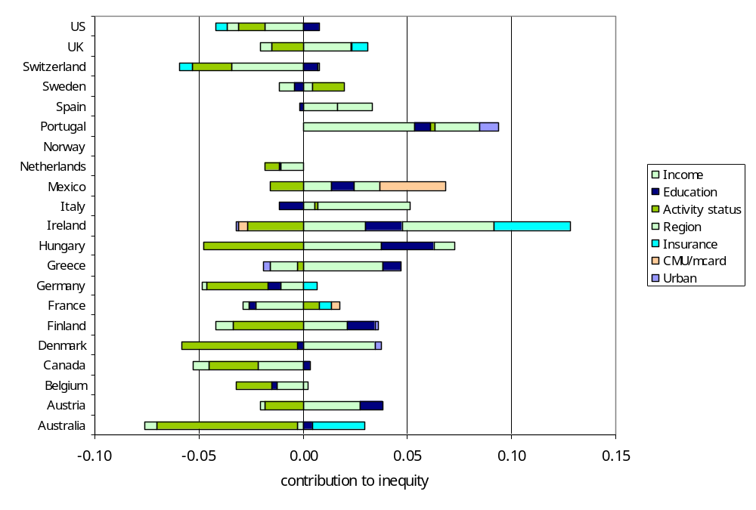
Decomposition of inequity in probability of hospital admission
Notes:
Note, this gives the decomposition of the inequity only. That is, it is the contribution of all the non-need factors. This is different to what is presented above for physician visits.
Activity status generally contributes to pro-poor inequity in hospital admissions.
The direction of the direct effect of income differs across countries.

